Slide 1
Lab 4 – jdbc project

Slide 2
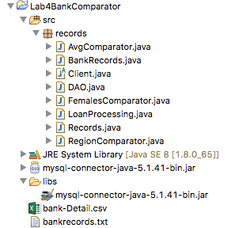
pROJECT package tree

Slide 3

Adding jar file to project’s build path
Create libs folder and add your mysql jar file into the folder

Slide 4
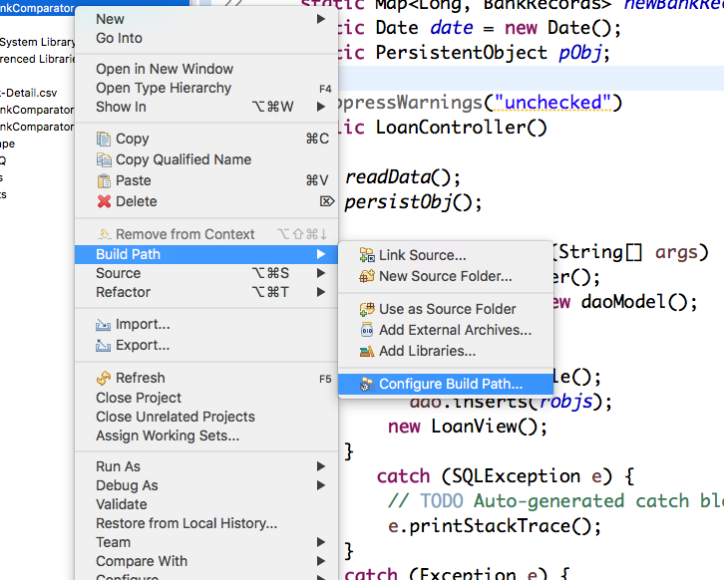
Configure build path
Right click on project & go to Build Path>Confiqure Build Path…

Slide 5
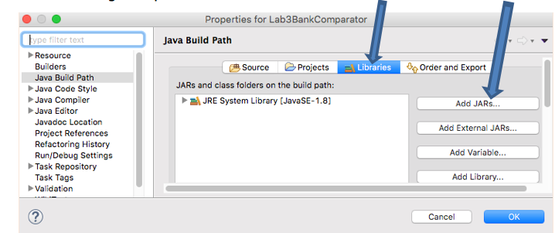
Choose add jaRs…under libraries tab

Slide 6
Apply dry principle for crud operations
Connector class?- Use for connections!
Basis: for code reuse
Need driver, connection object declared
Functionality:
getConnection(protocol:subprotocol:url) method
url arg above can contain query params-> db, login credentials, connection retries, SSL

Slide 7
Dao.java for crud methods
Needed imports
import java.sql.Connection;
import java.sql.DriverManager;
import java.sql.ResultSet;
import java.sql.SQLException;
import java.sql.Statement;

Slide 8
dao.java
Class level object Instantiation
Connection connect = null;
Statement stmt = null;

Slide 9
daomodel.java- for CRUD methods
// Setup the connection with the DB
connect = DriverManager
.getConnection("jdbc:mysql://www.papademas.net/411labs?user=db411&password=411");

Slide 10
daomodel.java- for CRUD methods
Create Table method
connect = DriverManager.getConnection(DB_URL, USER, PASS);
String sql = "CREATE TABLE j_papa_tab" +
"(pid INTEGER not NULL AUTO_INCREMENT, " +
" id VARCHAR(7), " +
" income NUMERIC(8,2), " +
" pep VARCHAR(3), " +
" PRIMARY KEY ( pid ))";

Slide 11
daomodel.java- CRUD methods
Create Table method con’t.
Initialize statement
stmt = connect.createStatement();
Execute statement
stmt.executeUpdate(sql);
Closing out connection object
connect.close();

Slide 12
daomodel.java- for CRUD methods
Insert Records method
try {
stmt = connect.createStatement();
//Loop thru bankrecord objects
sql = "INSERT INTO j_papa_tab(field 1,field 2 , field n) " +
"VALUES (’ "+value 1+” ', ’ "+value 2+” ', ’ "+value n+” ’ )";
stmt.executeUpdate(sql);
//end loop
}

Slide 13
daomodel.java- for CRUD methods
Retrieve Records method
public ResultSet getResultSet() throws Exception {
connect = DriverManager.getConnection(DB_URL, USER, PASS);
ResultSet rs = null;
try {
stmt = connect.createStatement();
String sql = "select …";
rs = stmt.executeQuery(sql);
} catch (SQLException e) { System.out.println(e.getMessage()); }
return rs;
}

Slide 14
loanProcessing.java- dao model executions
Needed imports
import java.sql.ResultSet;
import java.sql.SQLException;

Slide 15
loancontroller.java- dao model executions
Object instantiations needful for CRUD method executions
BankRecords instance
DAO instance

Slide 16
loancontroller.java- dao model executions
Trigger CRUD method executions
dao.createTable();
dao.insert(robjs); //perform inserts
ResultSet rs = dao.retrieveRecords(); //fill result set object

Slide 17
loancontroller.java- dao model executions
Cycle through result set
//Extract data from result set
while(rs.next()){
//Retrieve by column name
String id = rs.getString("id");
double income = rs.getDouble("income");
String pep = rs.getString("pep");
//Display values
}

